Slide 1

CHAPTER 4
ELEMENTARY
NUMBER THEORY
AND METHODS
OF PROOF
Copyright © Cengage Learning. All rights reserved.

Slide 2
SECTION 4.4
Direct Proof and Counterexample IV: Division into Cases and the
Quotient-Remainder Theorem
Copyright © Cengage Learning. All rights reserved.

Slide 3
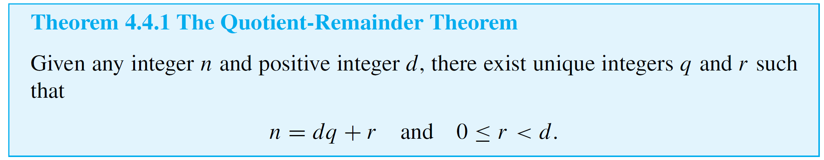
Direct Proof and Counterexample IV: Division into Cases and the Quotient-Remainder Theorem
The quotient-remainder theorem says that when any integer n is divided by any positive integer d, the result is a quotient q and a nonnegative remainder r that is smaller than d.

Slide 4


Example 1 – The Quotient-Remainder Theorem
For each of the following values of n and d, find integers q and r such that and
a. n = 54, d = 4 b. n = –54, d = 4 c. n = 54, d = 70
Solution:
a.
b.
c.

Slide 5
div and mod

Slide 6
div and mod
A number of computer languages have built-in functions that enable you to compute many values of q and r for the quotient-remainder theorem.
These functions are called div and mod in Pascal, are called / and % in C and C++, are called / and % in Java, and are called / (or \) and mod in .NET.
The functions give the values that satisfy the
quotient-remainder theorem when a nonnegative integer n is divided by a positive integer d and the result is assigned to an integer variable.

Slide 7
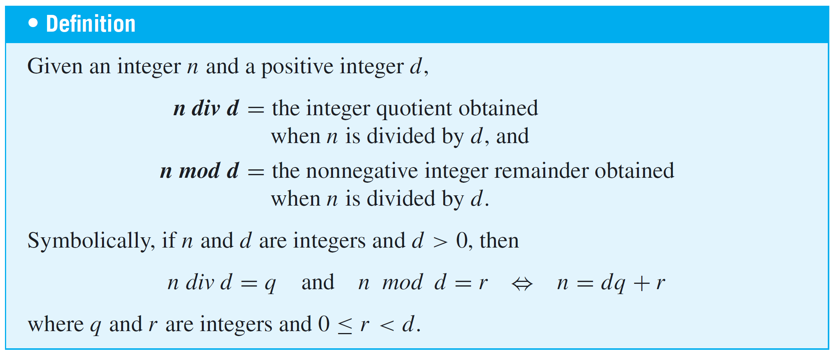
div and mod
However, they do not give the values that satisfy the quotient-remainder theorem when a negative integer n is divided by a positive integer d.

Slide 8



div and mod
For instance, to compute n div d for a nonnegative integer n and a positive integer d, you just divide n by d and ignore the part of the answer to the right of the decimal point.
To find n mod d, you can use the fact that if
then Thus
and so
Hence, to find n mod d compute n div d, multiply by d, and subtract the result from n.

Slide 9
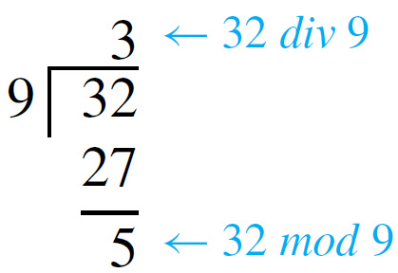
Example 2 – Computing div and mod
Compute 32 div 9 and 32 mod 9 by hand and with a calculator.
Solution:
Performing the division by hand gives the following results:
If you use a four-function calculator to divide 32 by 9, you obtain an expression like 3.555555556.

Slide 10

Example 2 – Solution
cont’d
Discarding the fractional part gives 32 div 9 = 3, and so
A calculator with a built-in integer-part function iPart allows you to input a single expression for each computation:

Slide 11
Representations of Integers

Slide 12
Representations of Integers
We have defined, an even integer to have the form twice some integer. At that time we could have defined an odd integer to be one that was not even.
Instead, because it was more useful for proving theorems, we specified that an odd integer has the form twice some integer plus one.
The quotient-remainder theorem brings these two ways of describing odd integers together by guaranteeing that any integer is either even or odd.

Slide 13

Representations of Integers
To see why, let n be any integer, and consider what happens when n is divided by 2.
By the quotient-remainder theorem (with d = 2), there exist unique integers q and r such that
But the only integers that satisfy are r = 0 and
r = 1.
It follows that given any integer n, there exists an integer q with

Slide 14


Representations of Integers
In the case that n is even. In the case that
n is odd. Hence n is either even or odd, and, because of the uniqueness of q and r, n cannot be both even and odd.
The parity of an integer refers to whether the integer is even or odd. For instance, 5 has odd parity and 28 has even parity.
We call the fact that any integer is either even or odd the parity property.

Slide 15
Example 5 – Consecutive Integers Have Opposite Parity
Prove that given any two consecutive integers, one is even and the other is odd.
Solution:
Two integers are called consecutive if, and only if, one is one more than the other. So if one integer is m, the next consecutive integer is m + 1.
To prove the given statement, start by supposing that you have two particular but arbitrarily chosen consecutive integers. If the smaller is m, then the larger will be m + 1.

Slide 16
Example 5 – Solution
cont’d
How do you know for sure that one of these is even and the other is odd? You might imagine some examples: 4, 5; 12, 13; 1,073, 1,074.
In the first two examples, the smaller of the two integers is even and the larger is odd; in the last example, it is the reverse. These observations suggest dividing the analysis into two cases.
Case 1: The smaller of the two integers is even.
Case 2: The smaller of the two integers is odd.

Slide 17
Example 5 – Solution
cont’d
In the first case, when m is even, it appears that the next consecutive integer is odd. Is this always true?
If an integer m is even, must m + 1 necessarily be odd?
Of course the answer is yes. Because if m is even, then
m = 2k for some integer k, and so m + 1 = 2k + 1, which is odd.
In the second case, when m is odd, it appears that the next consecutive integer is even. Is this always true? If an integer m is odd, must m + 1 necessarily be even?

Slide 18


Example 5 – Solution
cont’d
Again, the answer is yes. For if m is odd, then
for some integer k, and so
which is even.

Slide 19
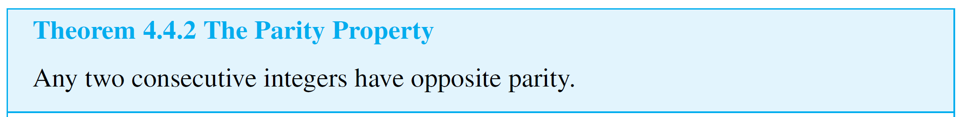
Example 5 – Solution
cont’d
This discussion is summarized as follows.
Proof:
Suppose that two [particular but arbitrarily chosen] consecutive integers are given; call them m and m + 1.
[We must show that one of m and m + 1 is even and that the other is odd.]

Slide 20
Example 5 – Solution
cont’d
By the parity property, either m is even or m is odd. [We break the proof into two cases depending on whether m is even or odd.]
Case 1 (m is even): In this case, m = 2k for some integer k, and so m + 1 = 2k + 1, which is odd [by definition of odd].
Hence in this case, one of m and m + 1 is even and the other is odd.

Slide 21
Example 5 – Solution
cont’d
Case 2 (m is odd): In this case, m = 2k + 1 for some integer k, and so .
But k + 1 is an integer because it is a sum of two integers. Therefore, m + 1 equals twice some integer, and thus
m + 1 is even.
Hence in this case also, one of m and m + 1 is even and the other is odd.

Slide 22
Example 5 – Solution
cont’d
It follows that regardless of which case actually occurs for the particular m and m + 1 that are chosen, one of m and
m + 1 is even and the other is odd. [This is what was to be shown.]

Slide 23

Representations of Integers
There are times when division into more than two cases is called for. Suppose that at some stage of developing a proof, you know that a statement of the form
is true, and suppose you want to deduce a conclusion C.
By definition of or, you know that at least one of the
statements A_{i} is true (although you may not know which).
In this situation, you should use the method of division into cases.

Slide 24
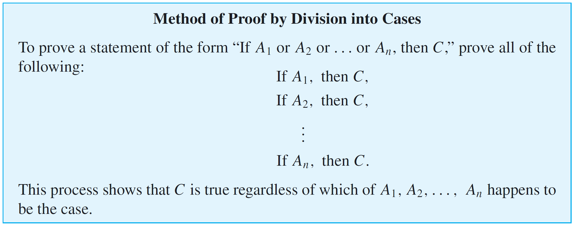
Representations of Integers
First assume A₁ is true and deduce C; next assume A₂ is true and deduce C; and so forth until you have assumed A_{n} is true and deduced C.
At that point, you can conclude that regardless of which statement A_{i} happens to be true, the truth of C follows.

Slide 25
Example 6 – Representations of Integers Modulo 4
Show that any integer can be written in one of the four forms
for some integer q.
Solution:
Given any integer n, apply the quotient-remainder theorem to n with d = 4.
This implies that there exist an integer quotient q and a remainder r such that

Slide 26
Example 6 – Solution
cont’d
But the only nonnegative remainders r that are less than 4 are 0, 1, 2, and 3.
Hence
for some integer q.

Slide 27

Example 7 – The Square of an Odd Integer
Prove: The square of any odd integer has the form 8m + 1 for some integer m.
Solution:
Begin by asking yourself, “Where am I starting from?” and “What do I need to show?” To help answer these questions, introduce variables to represent the quantities in the statement to be proved.
Formal Restatement: ∀ odd integers n, ∃ an integer m
such that
From this, you can immediately identify the starting point and what is to be shown.

Slide 28

Example 7 – Solution
cont’d
Starting Point: Suppose n is a particular but arbitrarily
chosen odd integer.
To Show: ∃ an integer m such that
This looks tough. Why should there be an integer m with the property that ?
That would say that (n² – 1)/8 is an integer, or that 8 divides n² – 1.

Slide 29
Example 7 – Solution
cont’d
That means that their product is divisible by 4. But that’s not enough. You need to show that the product is divisible by 8. This seems to be a blind alley.
You could try another tack. Since n is odd, you could represent n as 2q + 1 for some integer q.
Then

Slide 30
Example 7 – Solution
cont’d
It is clear from this analysis that n² can be written in the form 4m + 1, but it may not be clear that it can be written as 8m + 1. This also seems to be a blind alley.
You could try breaking into cases based on these two different forms.
It turns out that this last possibility works! In each of the two cases, the conclusion follows readily by direct calculation.

Slide 31
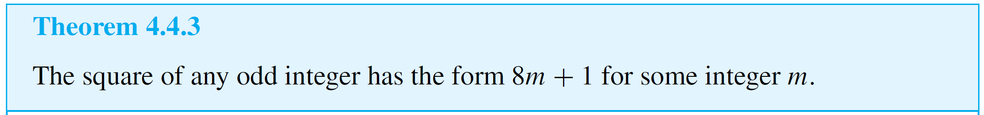

Example 7 – Solution
cont’d
The details are shown in the following formal proof:
Proof:
Suppose n is a [particular but arbitrarily chosen] odd
integer. By the quotient-remainder theorem, n can be
written in one of the forms
for some integer q.
In fact, since n is odd and 4q and 4q + 2 are even, n must have one of the forms

Slide 32








Example 7 – Solution
cont’d
Case 1 (n = 4q + 1 for some integer q): [We must find an integer m such that ]

Slide 33


Example 7 – Solution
cont’d
Let Then m is an integer since 2 and q are integers and sums and products of integers are integers.
Thus, substituting,
where m is an integer.

Slide 34






Example 7 – Solution
cont’d
Case 2 (n = 4q + 3 for some integer q): [We must find an integer m such that ]

Slide 35


Example 7 – Solution
cont’d
[The motivation for the choice of algebra steps was the desire to write the expression in the form
8  (some integer) + 1.]
Let Then m is an integer since 1, 2, 3, and q are integers and sums and products of integers are integers.
Thus, substituting,
where m is an integer.

Slide 36


Example 7 – Solution
cont’d
Cases 1 and 2 show that given any odd integer, whether of the form for some integer m. [This is what we needed to show.]

Slide 37
Representations of Integers
Note that the result of Theorem 4.4.3 can also be written, “For any odd integer n, n² mod 8 = 1.”
In general, according to the quotient-remainder theorem, if an integer n is divided by an integer d, the possible remainders are 0, 1, 2, . . ., (d – 1).
This implies that n can be written in one of the forms
for some integer q.

Slide 38
Representations of Integers
Many properties of integers can be obtained by giving d a variety of different values and analyzing the cases that
result.

Slide 39
Absolute Value and the Triangle Inequality

Slide 40
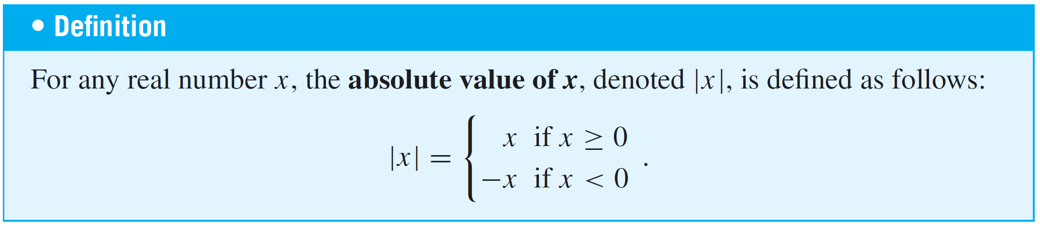
Absolute Value and the Triangle Inequality
The triangle inequality is one of the most important results involving absolute value. It has applications in many areas of mathematics.

Slide 41
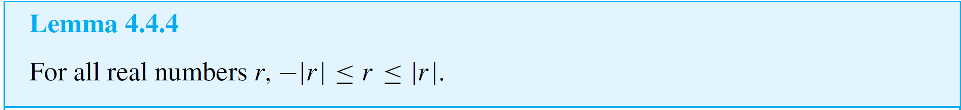
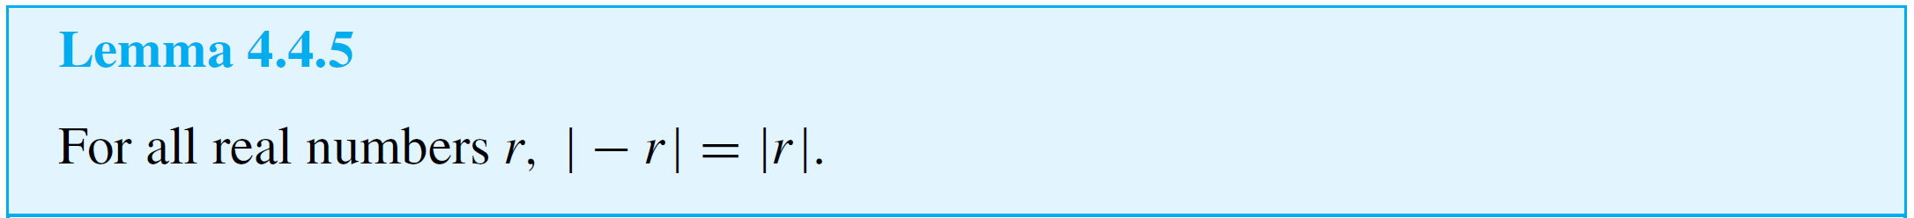
Absolute Value and the Triangle Inequality
A lemma is a statement that does not have much intrinsic interest but is helpful in deriving other results.

Slide 42
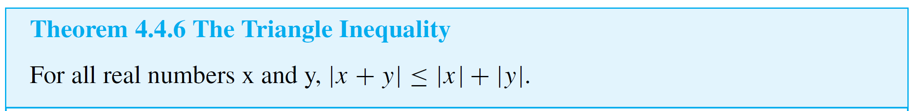
Absolute Value and the Triangle Inequality
Lemmas 4.4.4 and 4.4.5 now provide a basis for proving the triangle inequality.

